Slide 1
Trees and Tree Algorithms
Problem Solving with Algorithms & Data Structures Using Python

Slide 2
Objectives
To understand what a tree data structure is and how it is used
To see how trees can be used to implement a map data structure
To implement trees using a list
To implement trees using classes and references
To implement trees as a recursive data structure
To implement a priority queue using a heap

Slide 3
Trees
A tree data structure has a root, branches, and leaves
Trees are used in many areas of computer science
Operating systems
Graphics
Database systems
Computer networking

Slide 4
Examples of Trees
Animal taxonomy
File system hierarchy
Web page elements

Slide 5
Vocabulary and Definitions
Node
A node is a fundamental part of a tree
It can have a name (key) and additional information (payload)
Edge
An edge connects two nodes to show that there is a relationship between them
Root
The root of the tree is the only node in the tree that has no incoming edges
Path
A path is an ordered list of nodes that are connected by edges
Children
The set of nodes that have incoming edges from the same node are said to be the children of that node
Parent
A node is the parent of all the nodes it connects to with outgoing edges
Sibling
Nodes in the tree that are children of the same parent
Subtree
A subtree is a set of nodes and edges comprised of a parent and all the descendants of that parent
Leaf Node
A leaf node is a node that has no children
Level
The level of a node is the number of edges on the path from the root node to that node
Height
The height of a tree is equal to the maximum level of any node in the tree

Slide 6
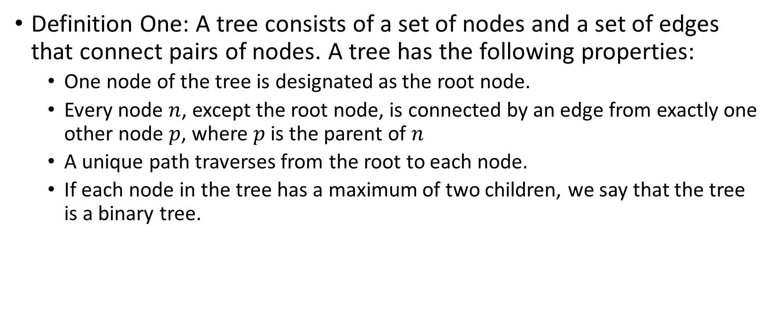
Vocabulary and Definitions
Definition One: A tree consists of a set of nodes and a set of edges that connect pairs of nodes. A tree has the following properties:
One node of the tree is designated as the root node.
Every node $n$, except the root node, is connected by an edge from exactly one other node $p$, where $p$ is the parent of $n$
A unique path traverses from the root to each node.
If each node in the tree has a maximum of two children, we say that the tree is a binary tree.

Slide 7
Vocabulary and Definitions
Definition Two: A tree is either empty or consists of a root and zero or more subtrees, each of which is also a tree. The root of each subtree is connected to the root of the parent tree by an edge.

Slide 8
Implementation

Slide 9
Tree ADT
BinaryTree()
Creates a new instance of a binary tree
get_root_val()
Returns the object stored in the current node
set_root_val(val)
Stores the object in parameter val in the current node
get_left_child()
Returns the binary tree corresponding to the left child of the current node
get_right_child()
Returns the binary tree corresponding to the right child of the current node
insert_left(val)
Creates a new binary tree and installs it as the left child of the current node
insert_right(val)
Creates a new binary tree and installs it as the right child of the current node

Slide 10
Implementation
List of lists
Nodes and references

Slide 11
Tree Traversals
Preorder
Visit the root node first
Recursively do a preorder traversal of the left subtree
Recursive preorder traversal of the right subtree
Inorder
Recursively do an inorder traversal on the left subtree
Visit the root node
Do a recursive inorder traversal of the right subtree
Postorder
Recursively do a postorder traversal of the left subtree
Recursive preorder traversal of the right subtree
Visit to the root node.

Slide 12
Priority Queues with Binary Heaps

Slide 13
Priority Queue
A priority queue acts like a queue in that you dequeue an item by removing it from the front
In a priority queue the logical order of items inside a queue is determined by their priority
The highest priority items are at the front of the queue
When you enqueue an item on a priority queue, the new item may move all the way to the front

Slide 14
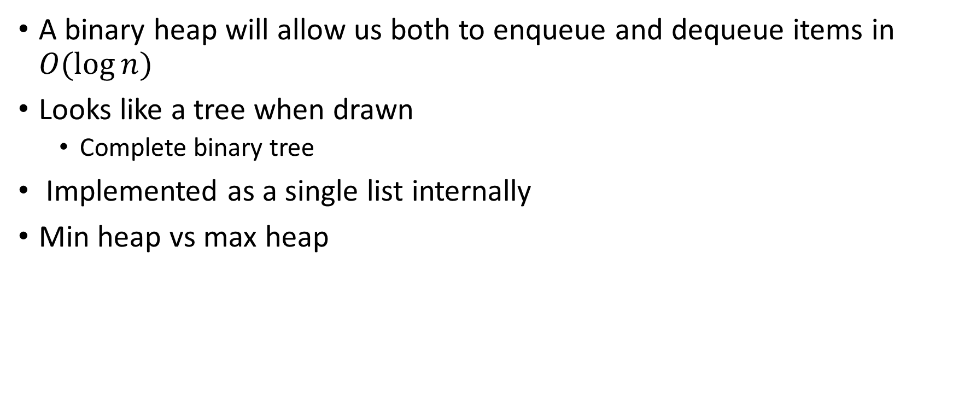
Binary Heap
A binary heap will allow us both to enqueue and dequeue items in $O(\log{n)}$
Looks like a tree when drawn
Complete binary tree
Implemented as a single list internally
Min heap vs max heap

Slide 15
Binary Heap Operations
BinaryHeap()
Creates a new empty binary heap
insert(k)
Adds a new item to the heap
get_min()
Returns the item with the minimum key value, leaving the item in the heap
delete()
Returns the item with the minimum key value, removing the item from the heap
is_empty()
Returns True if the heap is empty, False otherwise
size()
Returns the number of items in the heap
heapify(list)
Builds a new heap from a list of keys

Slide 16
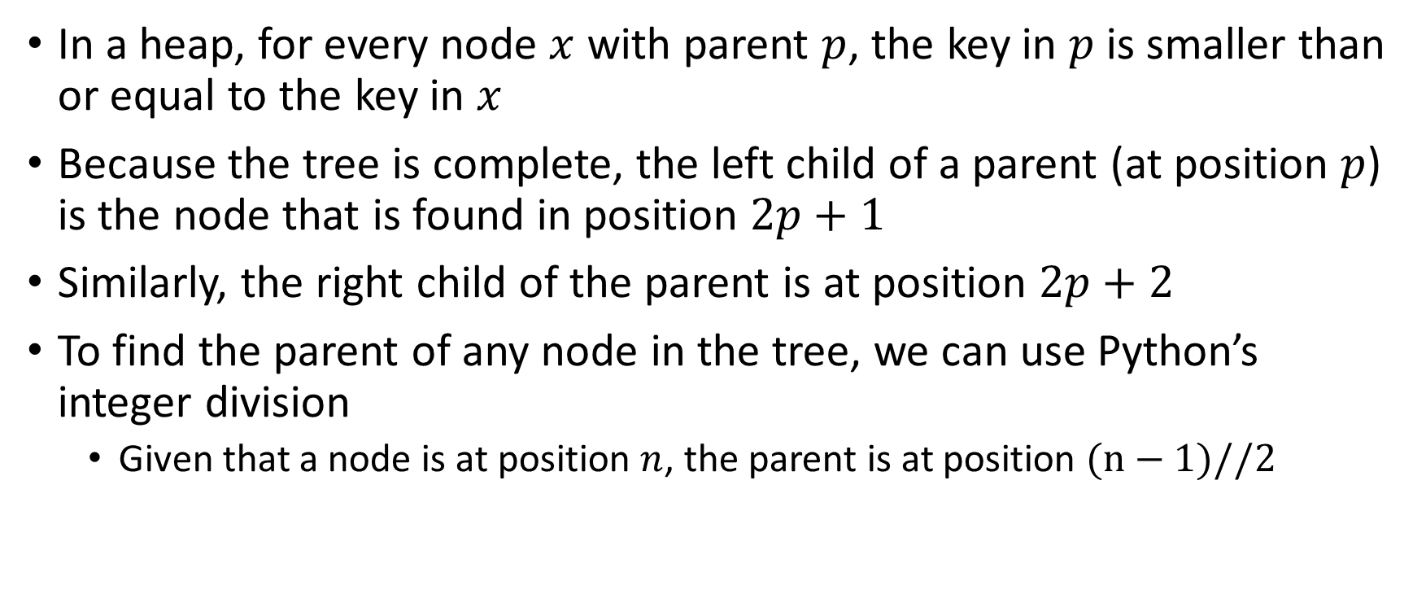
Binary Heap Implementation
In a heap, for every node $x$ with parent $p$, the key in $p$ is smaller than or equal to the key in $x$
Because the tree is complete, the left child of a parent (at position $p$) is the node that is found in position $2p+1$
Similarly, the right child of the parent is at position $2p+2$
To find the parent of any node in the tree, we can use Python’s integer division
Given that a node is at position $n$, the parent is at position $(n−1)//2$

Slide 17

Binary Heap Operations Complexity
Build heap
$O(n)$
Insert
$O\left(\log{n}\right)$
Delete
$O(\log{n)}$

Slide 18
Binary Search Trees

Slide 19
Binary Search Trees
A way to implement the map ADT
We are not interested in the exact placement of items in the tree
We are interested in using the binary tree structure to provide for efficient searching
Keys that are less than the parent are found in the left subtree
Keys that are greater than the parent are found in the right subtree

Slide 20
Search Tree Operations
Map()
Creates a new empty map
put(key, val)
Adds a new key–value pair to the map
If the key is already in the map, it replaces the old value with the new value
get(key)
Takes a key and returns the matching value stored in the map or None otherwise
Del
Deletes the key–value pair from the map using a statement of the form del map[key]
size()
Returns the number of key–value pairs stored in the map
in
Return True for a statement of the form key in map if the given key is in the map, False otherwise

Slide 21
Search Tree Implementation
Nodes and references

Slide 22

Search Tree Analysis
Average-case of putting and getting a key
$O(\log{n)}$
Worst-case of putting and getting a key
$O(n)$

Slide 23
Balanced Binary Search Trees

Slide 24
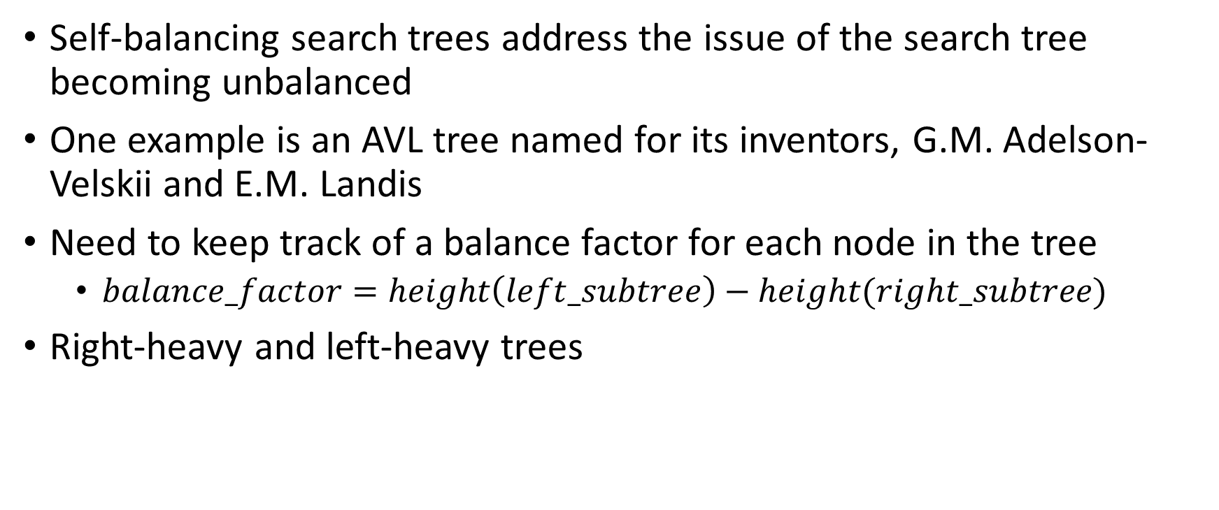
Balanced Binary Search Trees
Self-balancing search trees address the issue of the search tree becoming unbalanced
One example is an AVL tree named for its inventors, G.M. Adelson-Velskii and E.M. Landis
Need to keep track of a balance factor for each node in the tree
$balance_factor=height\left(left_subtree\right)−height(right_subtree)$
Right-heavy and left-heavy trees

Slide 25

AVL Tree Performance
Search
$O(\log{n)}$

Slide 26
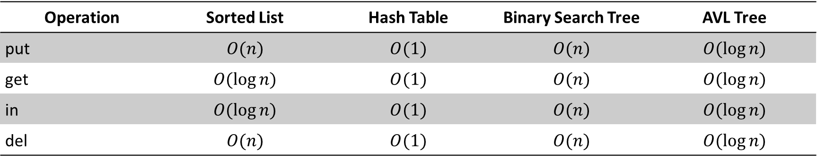
Summary of Map ADT Implementations
Operation | Sorted List | Hash Table | Binary Search Tree | AVL Tree
put | $$O(n)$$ | $$O(1)$$ | $$O(n)$$ | $$O(\log{n)}$$
get | $$O(\log{n)}$$ | $$O(1)$$ | $$O(n)$$ | $$O(\log{n)}$$
in | $$O(\log{n)}$$ | $$O(1)$$ | $$O(n)$$ | $$O(\log{n)}$$
del | $$O(n)$$ | $$O(1)$$ | $$O(n)$$ | $$O(\log{n)}$$

Slide 27
Summary
A binary tree for parsing and evaluating expressions
A binary tree for implementing the map ADT
A balanced binary tree (AVL tree) for implementing the map ADT
A binary tree to implement a min heap
A min heap used to implement a priority queue

